Slide 1
ALCOHOL DETECTON AND ENGINE OFF SYSTEM WITH GPS AND GSM
Primathon Idea Submission

Slide 2
INTRODUCTION
Drunk and drive is major problem in this world. Many accidents are occurring due to consuming alcohol and driving the vehicle. To stop this, we need a new process or idea. Drinking alcohol is injurious to health and driving after drinking is more harmful to the society. The drivers who drink alcohol are not in stable condition and also, rash driving occurs on highways which can be risky to lives of the people on the road and including driver. The laws in India are currently prohibiting drivers to drink and drive so that the fine can stop them to drink and drive.

Slide 3
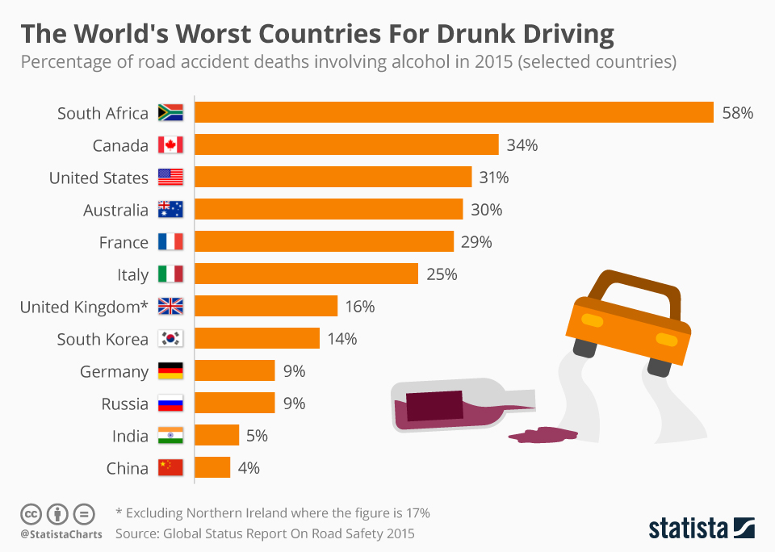
PROOFS AND STATISTICS

Slide 4
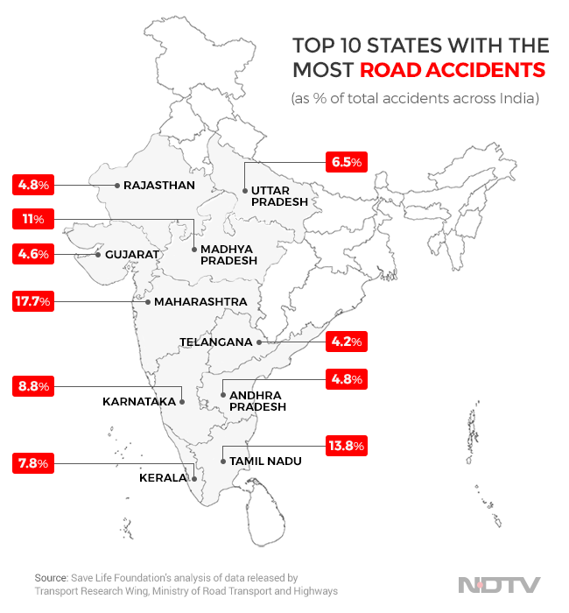

Slide 5
OBJECTIVES
The main objective of the project is to reduce accidents caused by the drunk and drive. Here we designed a smart alcohol detection system which helps in reducing accidents and saving people’s lives.
This system is designed in such a way that, when a person who consumed alcohol drives the car, the sensor detects the alcohol and stops the car and sends the location to registered mobile number so that we can stop the person to drive the vehicle. This system is designed in the way such that we can reduce time and space. This also reduces the work of policemen and road safety officers. This system does not allow the person who consumed alcohol to drive the vehicle. It also helps in reducing deaths caused by drunk and drive.

Slide 6
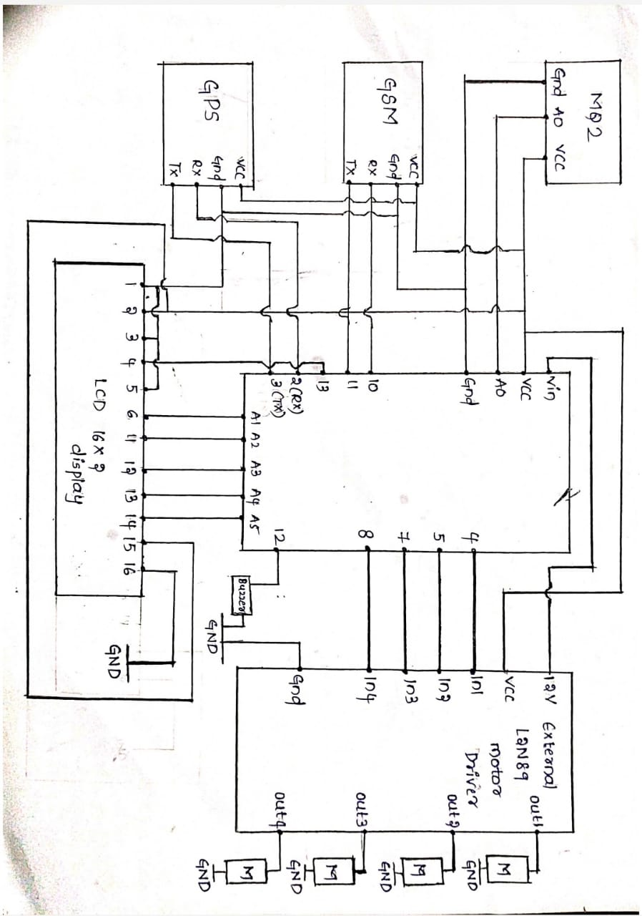

Block Diagram

Slide 7
RESULTS AND WORKING
MyYouTube-Video
Whenever a person driving vehicle consumes alcohol the gas sensor senses the ethanol percentage in the atmosphere and compares with limit or threshold value if the value detected is more than that knee point. Then car engine motors stops automatically and the GPS receiver extracts the latitude and longitude positions of that vehicle and sends as a map link to the registered mobile number via GSM. Thus, it helps the government to track drunk and driven vehicles easily.
If the detected value is less than knee value then car engine will run as it is.
An LCD and Buzzer is used so that it can be seen and visualized easily.

Slide 8

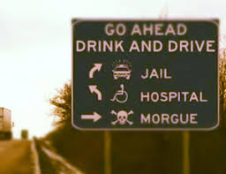
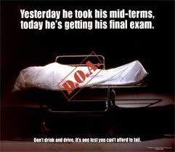
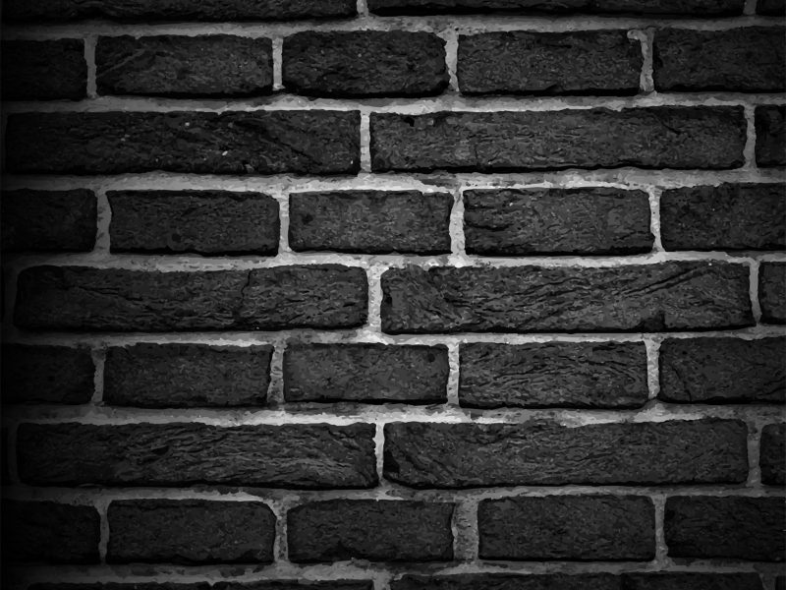
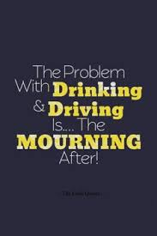
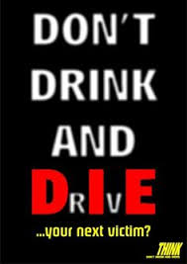
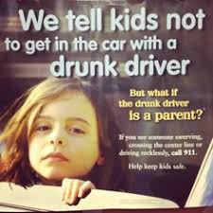
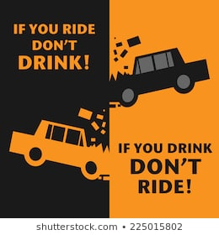
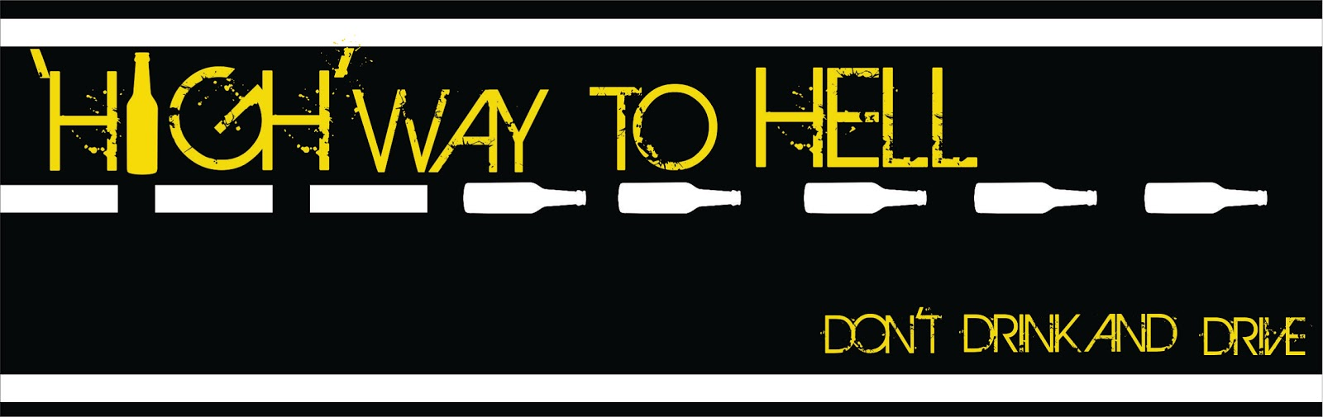

Slide 9
THANK YOU!

